Slide 1



PEILab Group Meeting
Leader: Zicong Hong
Team Member: Jian Lin, Haodong Wang, Qianli Liu, Kaibin Guo, Junjie Liu

Slide 2
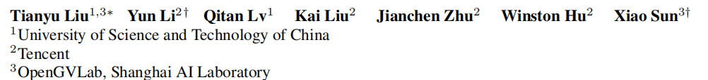
PEARL: PARALLEL SPECULATIVE DECODING WITH ADAPTIVE DRAFT LENGTH
ICLR 2025

Slide 3
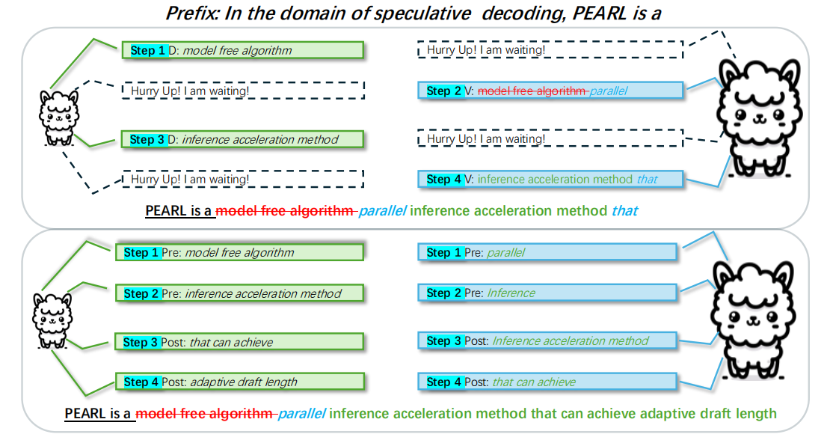
PEARL: PARALLEL SPECULATIVE DECODING WITH ADAPTIVE DRAFT LENGTH
Traditional SD:
Draft model generates tokens first, then target model verifies them in parallel. This causes mutual waiting, limiting efficiency.
PEARL:
Parallel Execution:
PEARL enables the draft model and target model to run in parallel, eliminating mutual waiting.
Adaptive Draft Length:
PEARL adjusts the draft length dynamically based on the verification results, optimizing efficiency.
[1] PEARL: PARALLEL SPECULATIVE DECODING WITH ADAPTIVE DRAFT LENGTH (ICLR 2025)

Slide 4
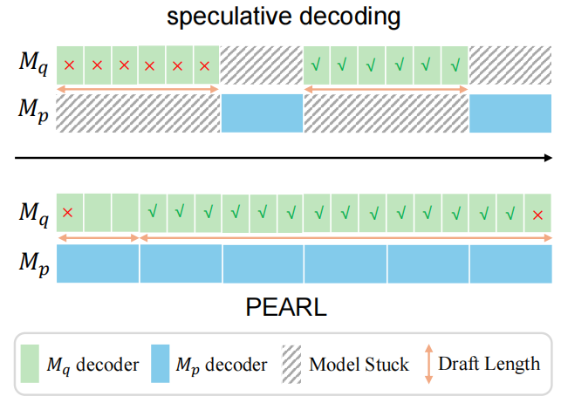
PEARL: PARALLEL SPECULATIVE DECODING WITH ADAPTIVE DRAFT LENGTH
Traditional SD:
Draft model generates tokens first, then target model verifies them in parallel. This causes mutual waiting, limiting efficiency.
PEARL:
Parallel Execution:
PEARL enables the draft model and target model to run in parallel, eliminating mutual waiting.
Adaptive Draft Length:
PEARL adjusts the draft length dynamically based on the verification results, optimizing efficiency.
[1] PEARL: PARALLEL SPECULATIVE DECODING WITH ADAPTIVE DRAFT LENGTH (ICLR 2025)

Slide 5
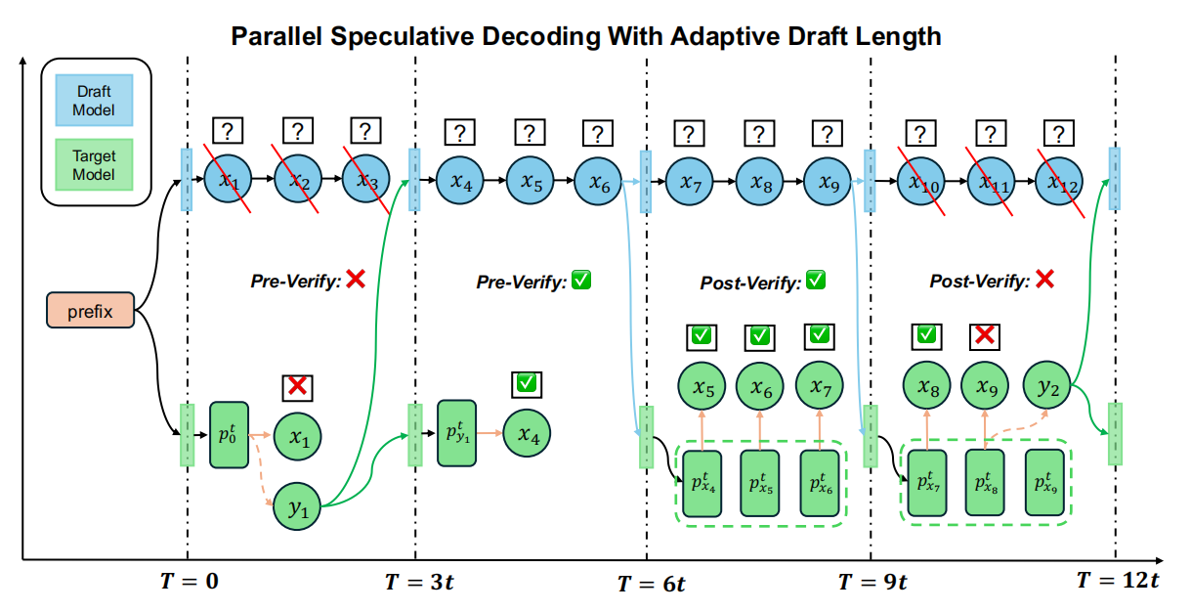
PEARL: PARALLEL SPECULATIVE DECODING WITH ADAPTIVE DRAFT LENGTH
PEARL
Introduces pre-verify and post-verify strategies.
Pre-verify :During the drafting phase, the target model verifies the first draft token in parallel. If the first token is rejected, subsequent draft tokens are discarded, and the next drafting phase begins immediately, reducing extra drafting.
Post-verify :During the verification phase, the draft model continues generating additional draft tokens. If all draft tokens are accepted, the draft model can generate more tokens without waiting for the next drafting phase.
[1] PEARL: PARALLEL SPECULATIVE DECODING WITH ADAPTIVE DRAFT LENGTH (ICLR 2025)

Slide 6
New Idea : Parallel Speculative Decoding with Dynamic Alignment
Junjie Liu
2025
[1] PEARL: PARALLEL SPECULATIVE DECODING WITH ADAPTIVE DRAFT LENGTH (ICLR 2025)
[2] Online Speculative Decoding (ICML 2024)

Slide 7





















Parallel Speculative Decoding with Dynamic Alignment
buffer
$$x_{1}$$
$$x_{2}$$
$$x_{3}$$
$$x_{4}$$
$$x_{5}$$
$$x_{6}$$
$$x_{7}$$
Distillation
$$x_{8}$$
$$x_{9}$$
$$x_{10}$$
Low confidence:×
stop decode
Pre-Verify:×
Pre-Verify:√
pre-Verify:√
prefix
√
√
√
$$x_{5}$$
$$x_{6}$$
$$y_{7}$$
×
√
√
$$p_{0}^{t}$$
$$p_{y_{1}}^{t}$$
$$p_{y_{1}}^{t}$$
$$p_{y_{1}}^{t}$$
$$p_{y_{1}}^{t}$$
$$p_{y_{7}}^{t}$$
$$x_{1}$$
$$x_{4}$$
$$x_{8}$$
$$y_{1}$$
$$x_{7}$$
×

Slide 8
Challenge
How to decide the length of a draft window?
How to execute the knowledge distillation ?

